Slide 1
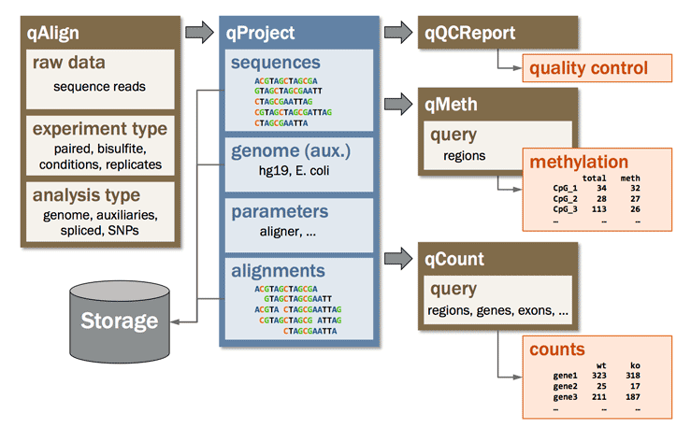
Quasr pipeline…

Slide 2
DESEQ2
result
Transformation, statistics,
Visualizations, Export…

Slide 3
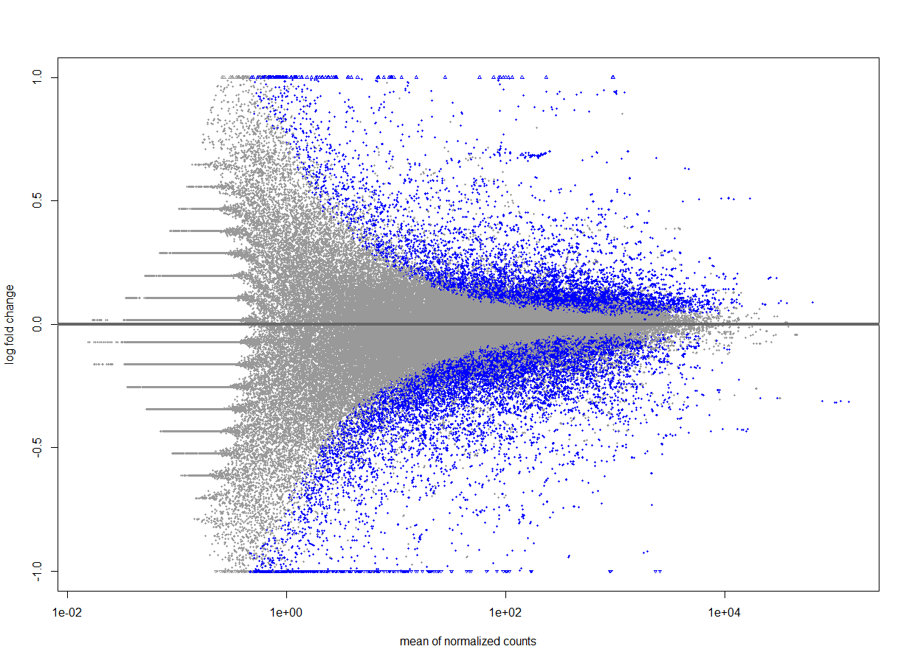
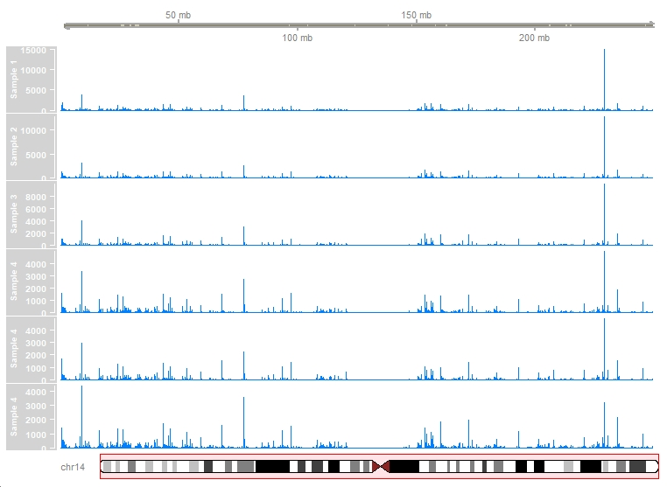

Slide 4
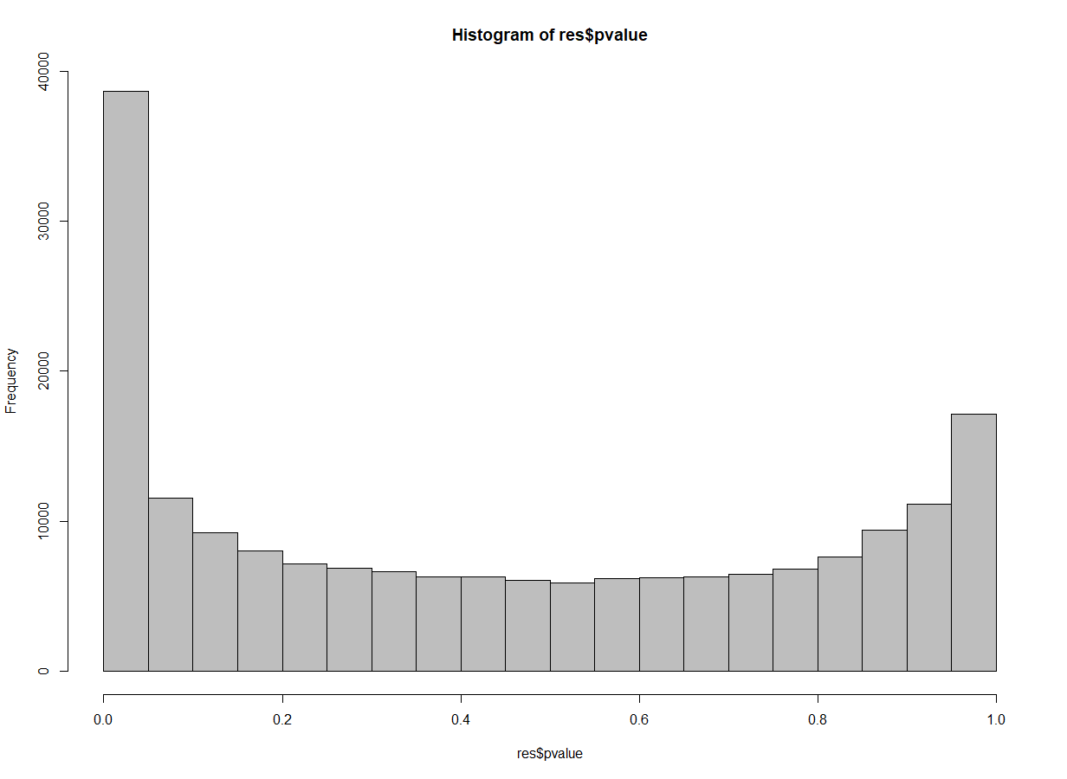
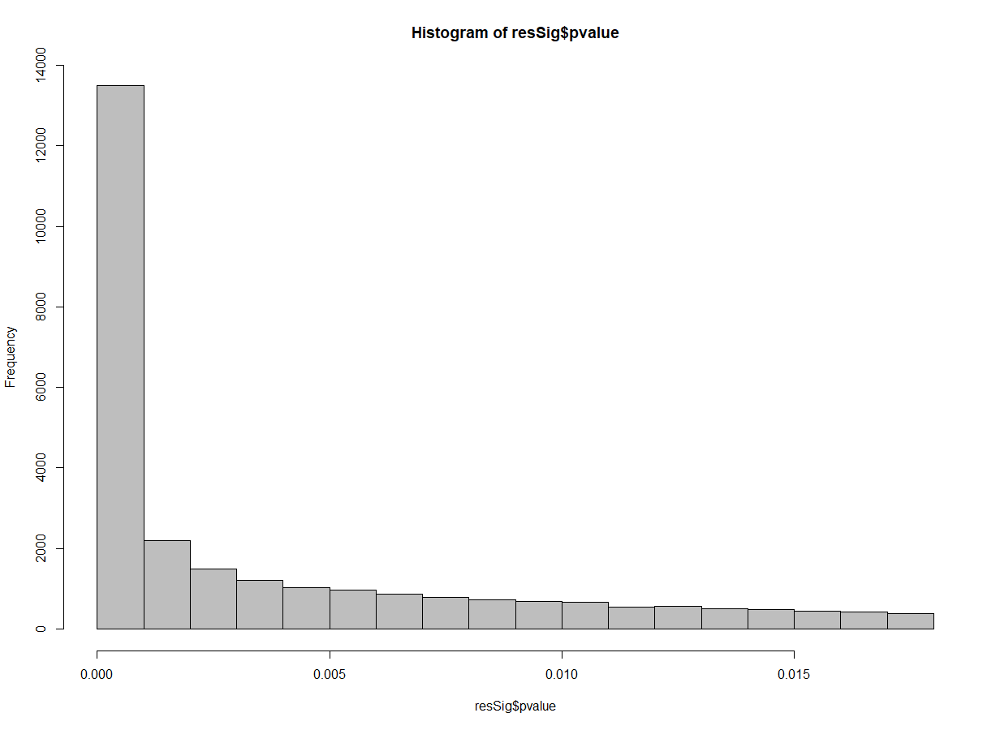

Slide 5
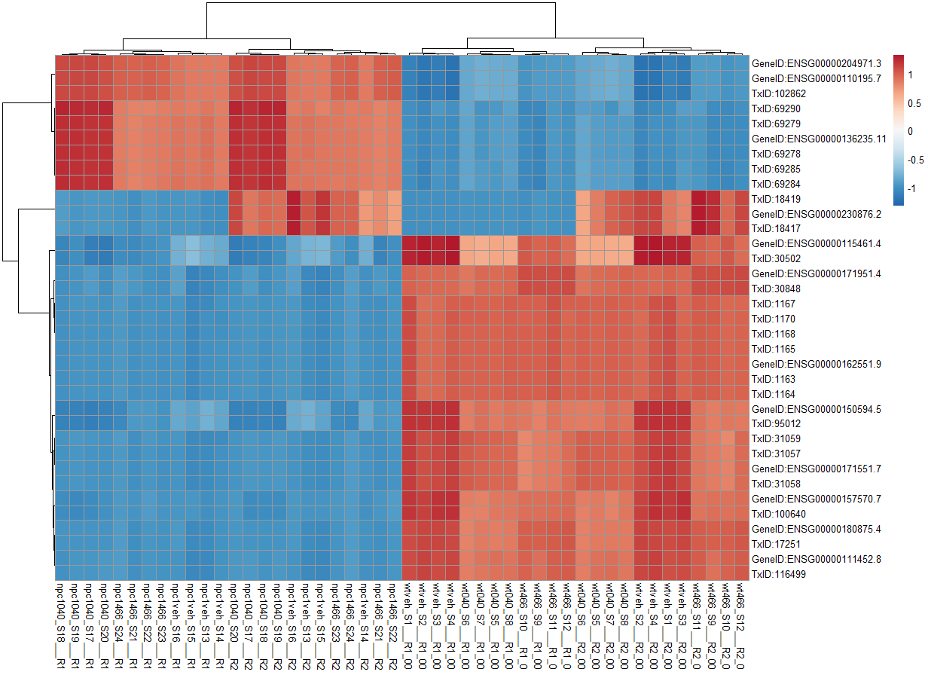
Top 35 genes with the Highest count variation

Slide 6
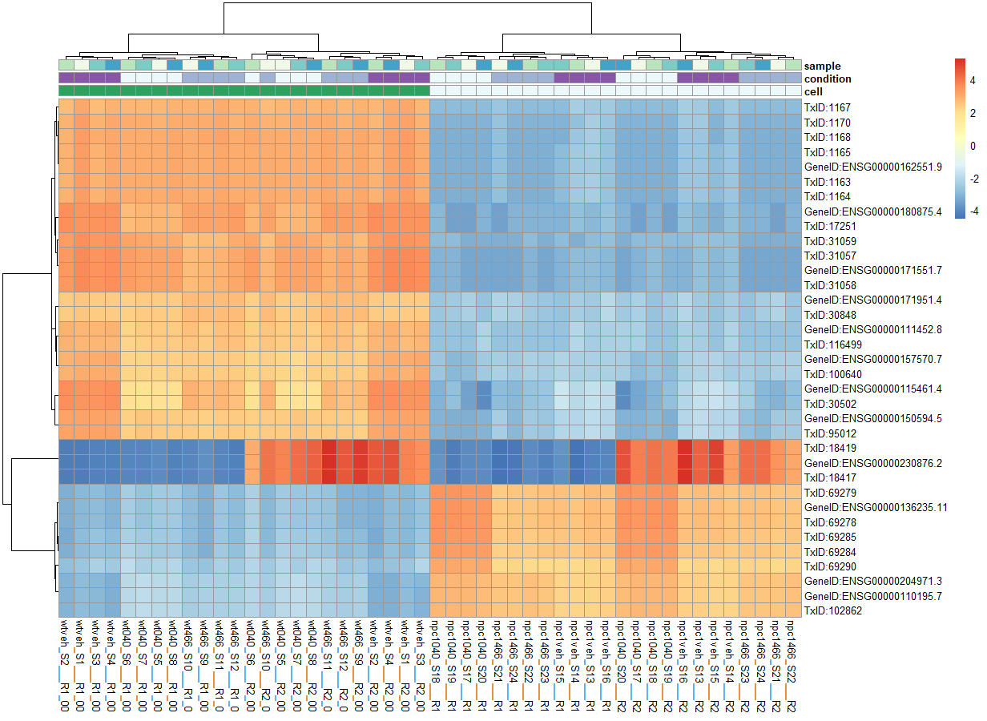
Top 35 genes with the deviation from the mean

Slide 7
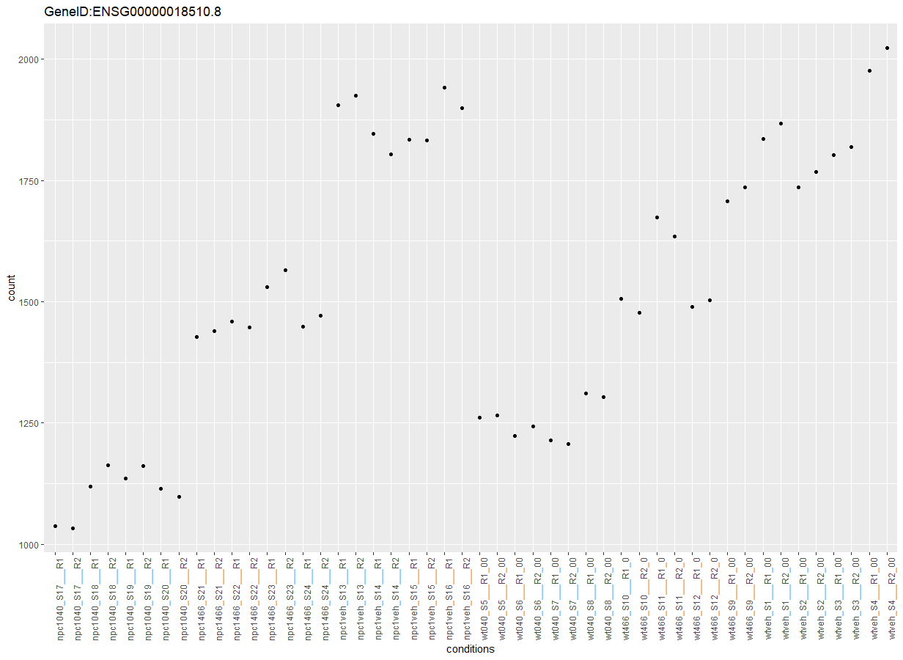
Gene with the highest “padj” value across Treatments

Slide 8
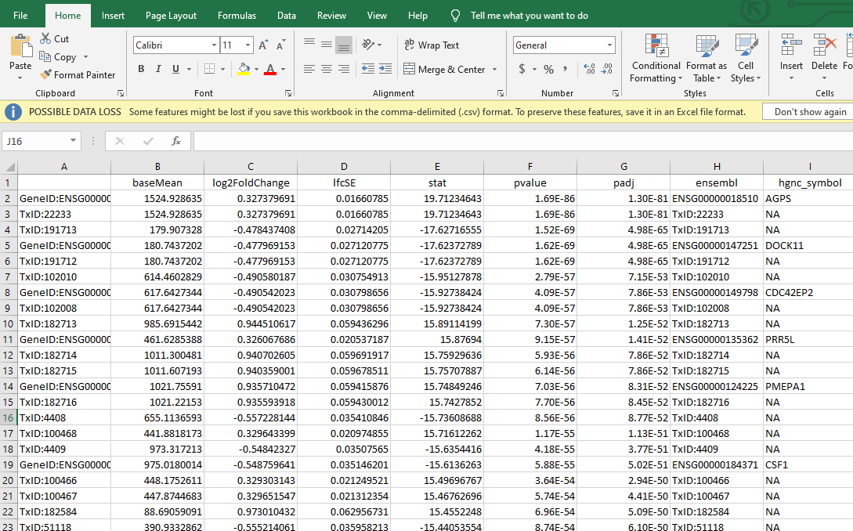
Export of Top 100 most signigicant
Gene | Function
AGPS | Enzyme found in perioxsomes
DOCK11 | Extracellular signaling
CDC42EP2 | Cell shape and motility
CSF1 | Hematpoietic growth factor
FBLN5 | Promotes adhesion of endothelial cells

